Slide 1
Project 2 - Ames Housing Data
DSIF3 Group 2

Slide 2


Slide 3
Welcome!
Property Flipping Masterclass
11 Dec 2011

Slide 4





Team Proprata
Shu
Cheng Yeow
Sean
Kris

Slide 5
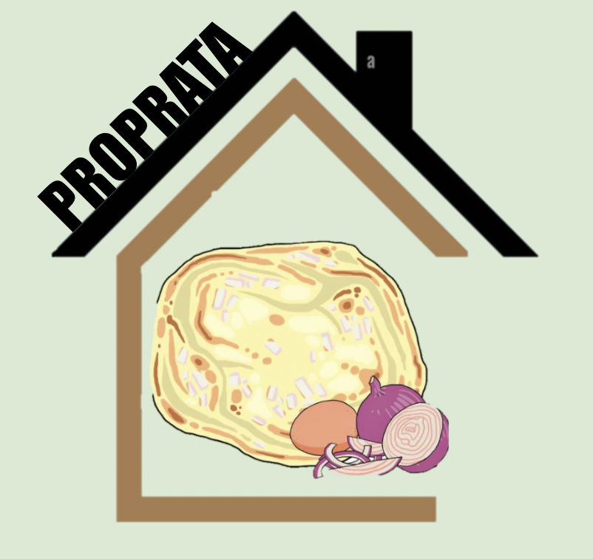
Prop Flippin’
be
Flippin’ EZ

Slide 6
Today’s masterclass
01
02
03
04
Introduction
Our Secret to Success
Problem Statement
Data Cleaning, EDA, Visualizations
Our Winning Formula
What We Have to Offer
Modeling and Evaluation
Conclusion and Recommendations

Slide 7
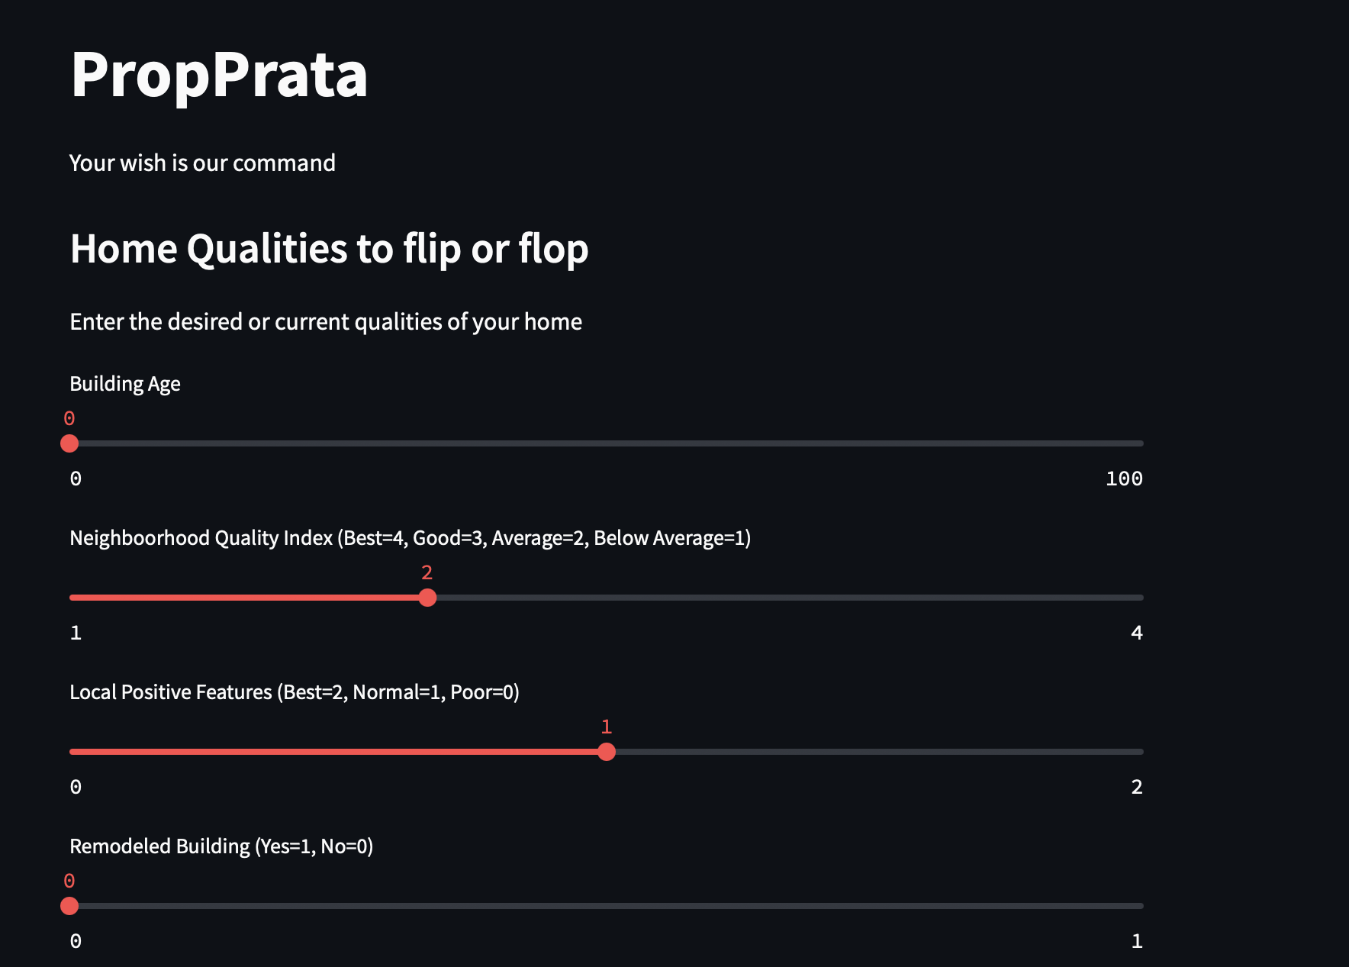
Live Software
Demo

Slide 8
01
Problem Statement
Introduction

Slide 9
Introduction
Property flipping is an investment strategy of purchasing a property with a short holding period with the intent of selling it for a quick profit. All investments have risks.
SELL
HIGH
BUY
LOW

Slide 10

Two types of property flipping
Hot Market Conditions
Renovation
Flip
Rapidly appreciating market
Little to no renovation
Higher risk
Buys undervalued property
Improves with renovation
Lower risk
Notes:
The hot market flip is where real estate investors target properties that are in a rapidly appreciating market and resell with little or no additional investment in the physical property. This is a play on the market conditions rather than the property itself.
The reno flip, in which a property flipper improves undervalued properties with renovations and/or cosmetic changes, is deemed less risky.

Slide 11
Problem Statement
To help novice property flippers manage risks, we will provide consultation upon application, based on our home valuation that predicts the sale prices of homes in Ames, Iowa. We have modeled Linear Regression, Ridge, Lasso and Elastic Net models. The sale price prediction software is also helpful for property buyers or sellers.
To better manage risks for new property flippers, we recommend the Reno Flip.
Thus, our recommendations will focus on property features that are more likely to increase property value when renovated, and which features to de-prioritise.
Notes:
To those about to buy a property, our objective is to share our home valuation model that predicts the sale prices of homes in Ames, Iowa. We have modelled Linear Regression, Ridge, Lasso and Elastic Net models.
To better manage risk, we recommend the Reno Flip.
To help the novice property flippers, our recommendations will focus on features that are more likely to increase property value when renovated, and which features to de-prioritise.
Is it clear what the student plans to do? Y - helping novice property flippers manage risks by dispelling common myths of property flipping, and providing a more detailed home valuation model, and presenting some heursiteics sp?? To layperson
What type of model will be developed? LR, Ridge, Lasso
How will success be evaluated? Impress on audience our superior home valuation model, and what features when renovated will fetch a higher price
Is the scope of the project appropriate? Y - with the current model, there are limitations due to the data points provided at 2006 and 2010?? 2011. This is not a time sensitive model, thus, hot market predictions are not suitable.
Is it clear who cares about this or why this is important to investigate? Y - hopefully our target audience, but really it is us who need to pass project 2.
Does the student consider the audience and the primary and secondary stakeholders? Target audience: Novice property flippers looking to flip properties at AMES. Primary extended to property buyers or sellers

Slide 12
Michael Ferrara
“Success in real estate starts when you believe you are worthy of it.”

Slide 13
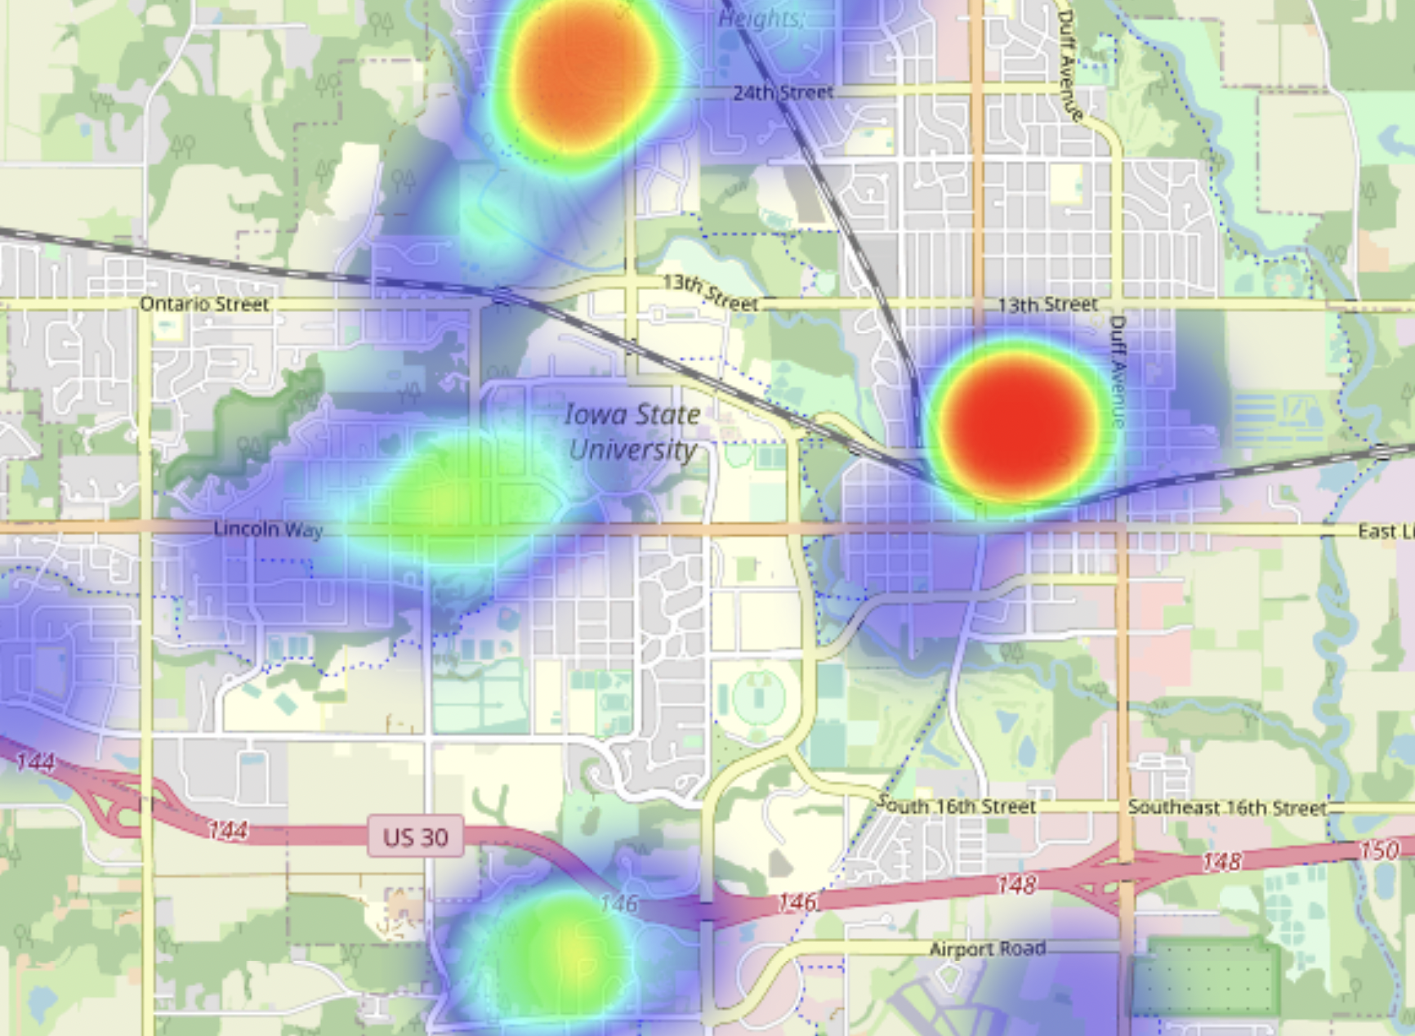
Location,
Location,
Location.
Heatmap of sale prices of properties in Ames.

Slide 14
02
Data Cleaning, EDA, Visualizations
Our Secret to Success
Notes:
Let me share with you on success secret, our data from 2006 to 2010

Slide 15
Exploring the data
2,051
*
80
=
164,080
Properties
Features
Data points
Sale of Ames properties in
2006 - 2010
Such as
Basement conditions, kitchen quality.
Bits of information

Slide 16
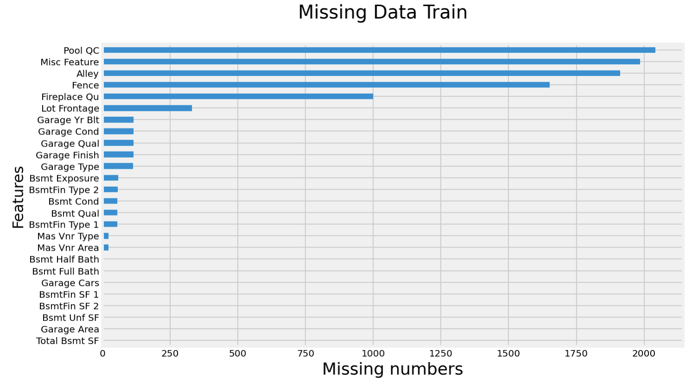
26
Features with missing data
9,822
Total missing data

Slide 17
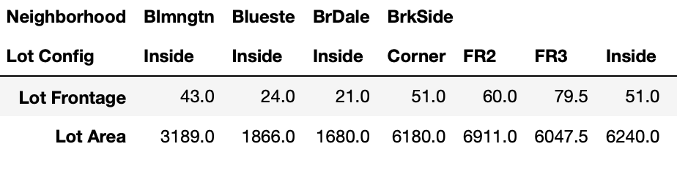
Dealing with missing data - Example
Lot Frontage
Neighborhood - Lot Config
Filled missing values with median
Corner
CulDSac
FR2
FR3
Inside
Transformation

Slide 18
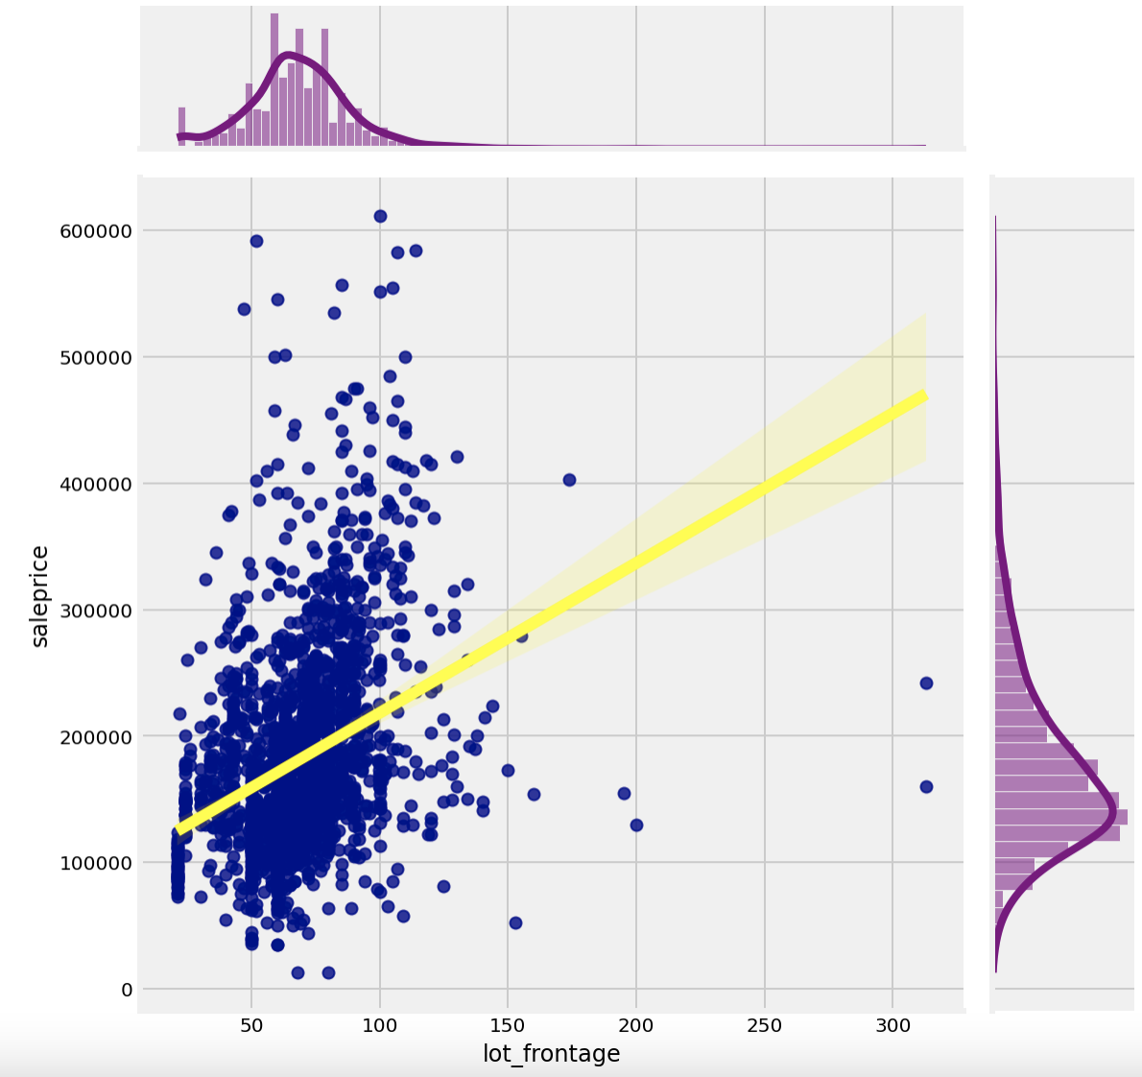
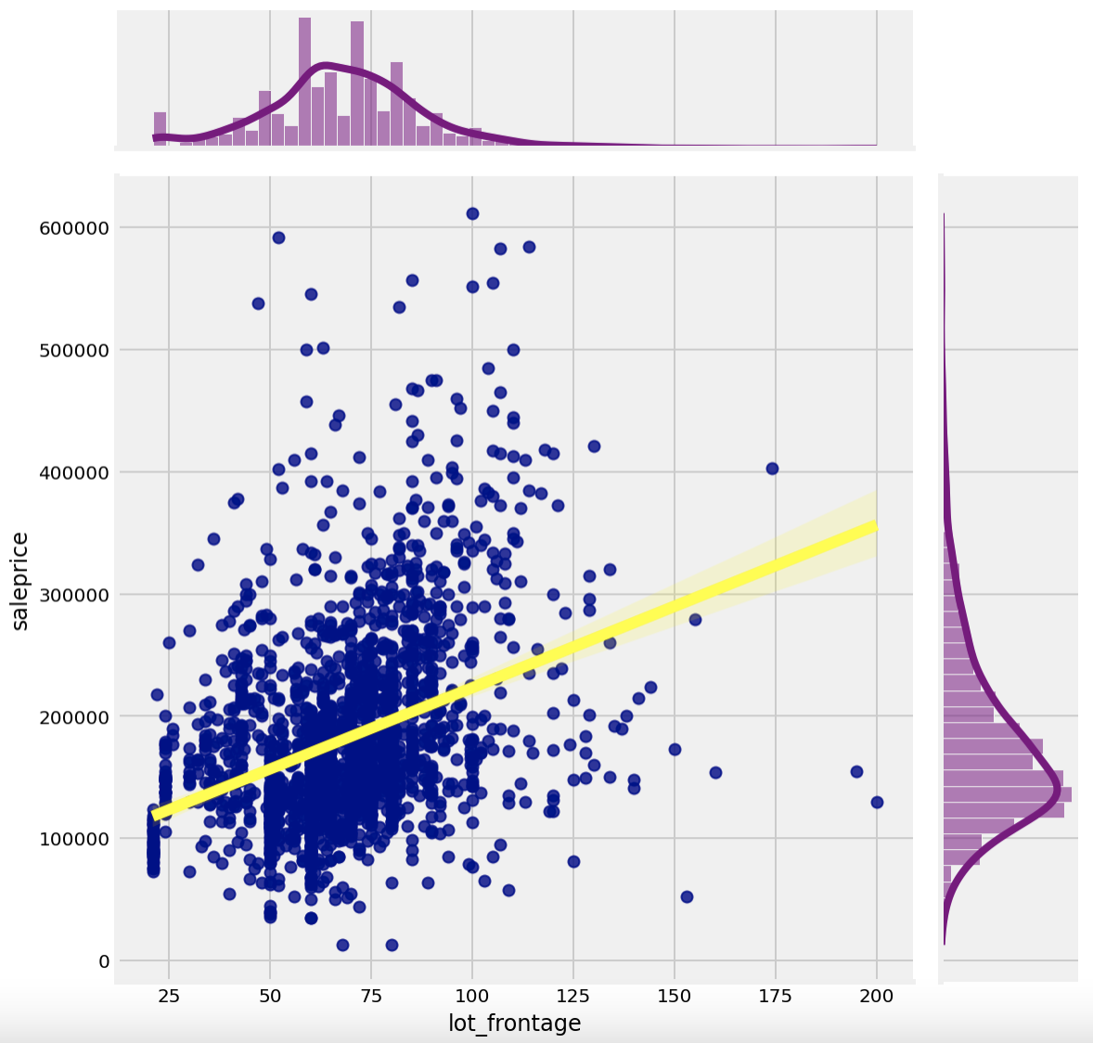
Dealing with outliers - Lot frontage
Outliners

Slide 19
Feature Engineering - Neighborhood
Type of variable
Transformation
Features
Ordinal
Mapping of text to numeric
'Ex': 5,'Gd': 4,'TA': 3, 'Fa':2,'Po':1
Neighborhood, Kitchen quality

Slide 20
Feature Engineering - Example -KIV
Neighborhood Order | Avg Sale Price | No. of Properties
1 | 124,518 | 399
2 | 150,775 | 791
3 | 198,180 | 455
4 | 278,513 | 406
Neighborhood Feature
Classify using the mean value of overall quality & condition, external quality & condition and functional features

Slide 21
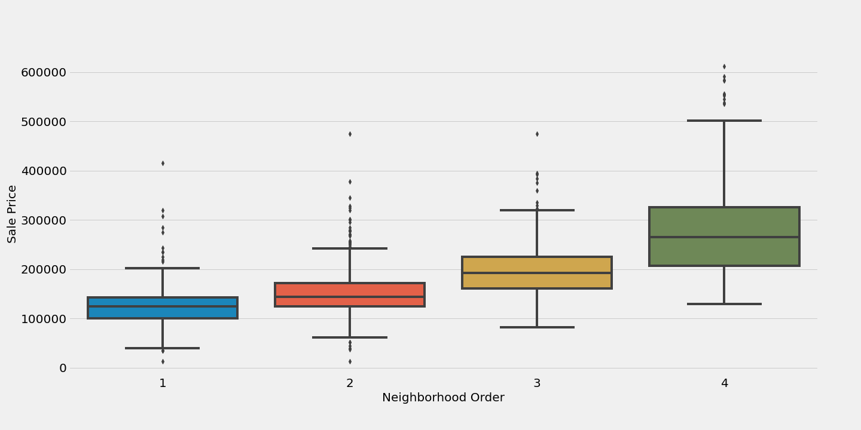
Feature Engineering - Neighborhood Example

Slide 22
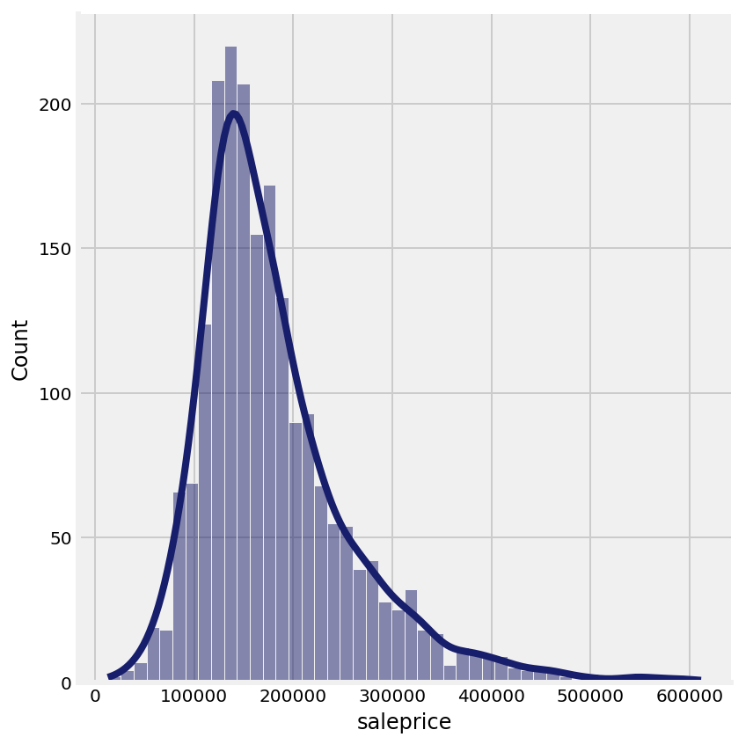
Cleaned Data
80
Original features
33
Useful features/ group of features

Slide 23
03
Modeling and Evaluation
Our winning formula
Notes:
Thank you Cheng Yeow for sharing the informative but fruitful experience of managing the data. But you might be wondering, what is the winning formula to help you novice property flippers?

Slide 24
Firstly.. A look at profits without ProPrata’s help!
Losses in potential profits of up to $70000 and more.
Notes:
Without the advise of Proprata or any other home valuation companies, property flippers have reported losses in potential profits of up to $70000, which is what we term the baseline score. Do you like to earn more or earn less? Of course more right? That’s why we’re here.
(For shiba and leo: This is based on RMSE baseline score and selected model’s RMSE score)

Slide 25
With ProPrata’s help, profits have gone up as much as $48000!
Notes:
However, with the help of Proprata, novice and intermediate property flippers alike have reported to have been able to cut down these losses to about $20000. This means, their additional profits would be as high as $48000!
(For shiba and leo: This is based on RMSE baseline score and selected model’s RMSE score)

Slide 26
But how did we do it?
Let’s take a look at our Proprata’s formula VS other companies’ formula!
Notes:
Now, our model works through promising higher profits and suggestions of easy to modify features that will appeal to novice property flippers.
Does our formula really work better compared to other companies? We have the numbers to prove it.

Slide 27
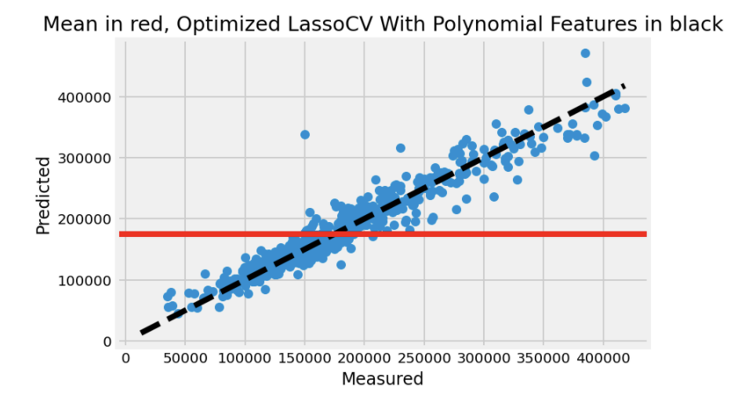
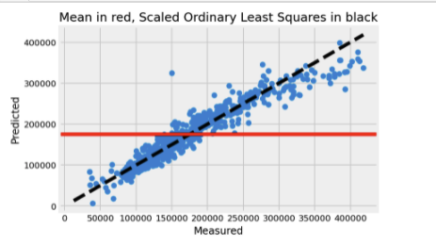
Proprata’s Model
Coy A’s Model
Prediction buffer
$20,253.00 Predictive power past clients 92% prospective clients 93%
Prediction buffer
$22,692.69 Predictive power past clients 89% prospective clients 90%
Notes:
Our model will be compared against various companies
As you can, our model have successfully reduced the prediction error (i.e. RMSE) by at least $3000 more as compared to other’s company. This in turn has helped novice property flippers achieve at least an additional value of $3000 dollars profit compared to company A.
In the beginning, we created our amazing model by training it, and derived a model with a whopping 92% predictive power (R2 score) which is able to forecast/predict the sale prices of houses on past clients who have approached us after they follow our advice on changing specific features in their house. This model performs at least 3% better than Company A’s model when they tried using their own models for past clients.
Our AMAZING model has also been shown to be able to likely predict (with an added 3% accuracy as compared to Company A’s) accurately the sale prices of houses on prospective clients. From here, we are also able to generate the best features which would help novice property flippers

Slide 28
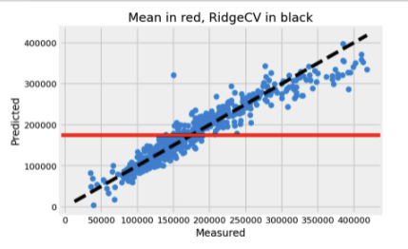
Proprata’s Model
Coy B’s Model
Prediction buffer
$20,253.00 Predictive power past clients 92% prospective clients 93%
Prediction buffer
$22,673.49 Predictive power past clients 89% prospective clients 90%
Notes:
Company b ‘s prediction buffer does slightly better than company A’s, but still not as good as Proprata’s. Their model’s predictive power is somewhat similar to company A’s as well.

Slide 29
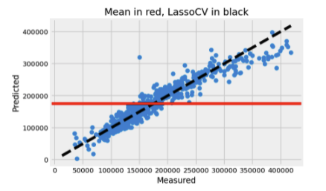
Proprata’s Model
Coy C’s Model
Prediction buffer
$20,253.00 Predictive power past clients 92% prospective clients 93%
Prediction buffer
$22,685.97 Predictive power past clients 89% prospective clients 90%
Notes:
We can skip company, since it;’s prediction buffer does poorer than company B.

Slide 30
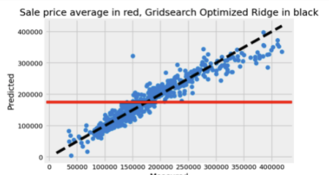
Proprata’s Model
Coy D’s Model
Prediction buffer
$20,253.00 Predictive power past clients 92% prospective clients 93%
Prediction buffer
$22,676.54 Predictive power past clients 89% prospective clients 90%
Notes:
Company D and E are mostly similar, with insignificant differences in their prediction buffer.

Slide 31
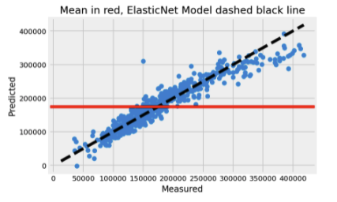
Proprata’s Model
Coy E’s Model
Prediction buffer
$20,253.00 Predictive power past clients 92% prospective clients 93%
Prediction buffer
$22,752.07 Predictive power past clients 89% prospective clients 90%
Notes:
Company D and E are mostly similar, with insignificant differences in their prediction buffer.

Slide 32
$20,253.00
Proprata’s Optimized LassoCV with Polynomial Features Model
92%
93%
Prediction buffer
Predictive power : past clients
Predictive power : prospective clients
Notes:
Our Proprata’s optimized lasso CV with poynomila features regression model performs the ebay.

Slide 33
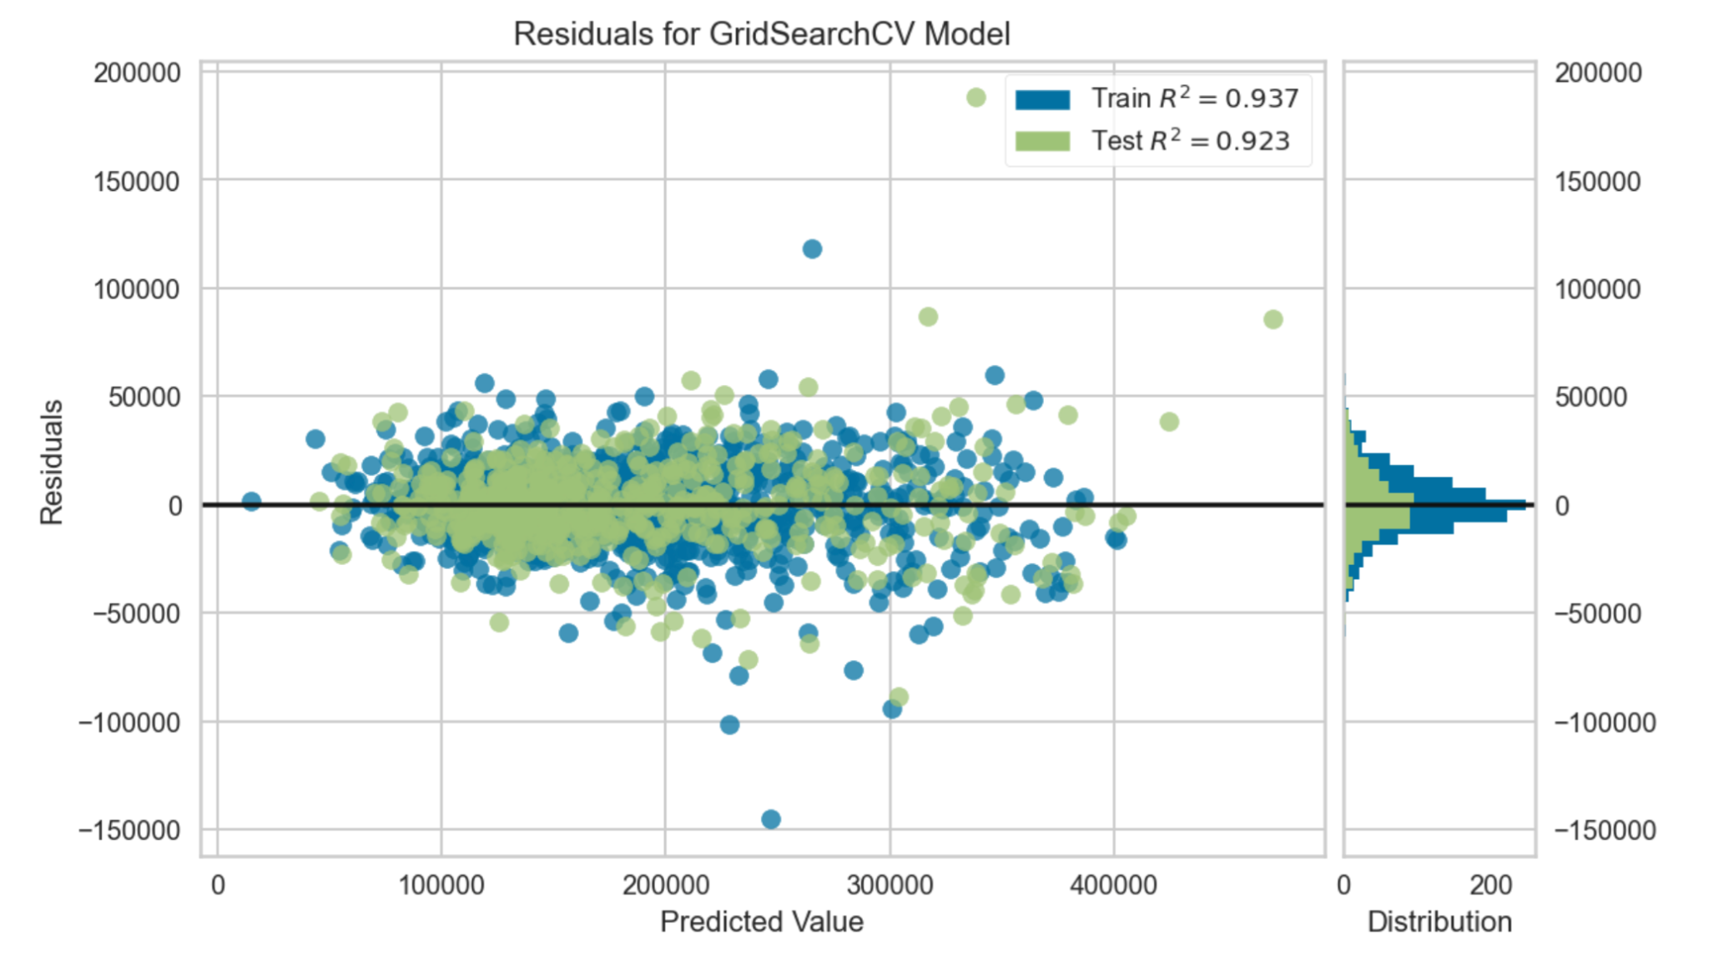
The Predictive Power of Proprata’s Model
Notes:
Critiques have evaluated our model and they themselves are surprised at how accurate our model can predict the sale prices of the houses after modifying features based on ProPrata’s advice. By using what critiques call a residuals plot, most of our datapoints (from our past and prospective clients) centre around zero, which indicate that the model’s prediction are correct on average.

Slide 34
19591.74
Kaggle Submission Score
Notes:
Recently, our model was nominated at the US Property Awards - Kaggle, which is the most respected and most sought-after real estate industry honours. Our model was able to reduce the prediction error to $19500 and we were voted one of the best up-and-coming home valuation models.
Now that we’ve seen how the power of our model, my fellow friend Kris will be happy to make recommendations to you. On to you Kris.

Slide 35
04
Conclusion and Recommendations
What we have to offer

Slide 36
Top 20 Features
Rank | Features | Rank | Features
1 | Rooms above size | 11 | External features
2 | Single storey | 12 | Garage area
3 | Basement ceiling | 13 | Ground living area
4 | Outside space | 14 | Lot size
5 | Neighbourhood quality | 15 | Kitchen quality
6 | Local features | 16 | Basement size
7 | Fireplace quality | 17 | Duplex building
8 | Paved driveway | 18 | Remodeled
9 | Lot frontage | 19 | Heating quality
10 | Floor size | 20 | Basement quality

Slide 37



Features to buy into:
Rooms above Size
Single Storey
Neighborhood Quality
Notes:
The hot market flip is where real estate investors target properties that are in a rapidly appreciating market and resell with little or no additional investment in the physical property. This is a play on the market conditions rather than the property itself.
The reno flip, in which a property flipper improves undervalued properties with renovations and/or cosmetic changes, is deemed less risky.

Slide 38



Features to reno:
Fireplace Quality
Paved Driveway
Kitchen Quality
Notes:
The hot market flip is where real estate investors target properties that are in a rapidly appreciating market and resell with little or no additional investment in the physical property. This is a play on the market conditions rather than the property itself.
The reno flip, in which a property flipper improves undervalued properties with renovations and/or cosmetic changes, is deemed less risky.

Slide 39


Insignificant features:
Roof Quality
Age
Bath Rooms
Notes:
The hot market flip is where real estate investors target properties that are in a rapidly appreciating market and resell with little or no additional investment in the physical property. This is a play on the market conditions rather than the property itself.
The reno flip, in which a property flipper improves undervalued properties with renovations and/or cosmetic changes, is deemed less risky.

Slide 40
Customised recommendations
Case Study
Seller X
Consultation
Renovation
Result
Budget
constraints
Went through our winning formula and took our advice.
Upgraded his fireplace for
Predicted increase
in saleprice
$280
$2838

Slide 41
TODAY only.
Notes:
Non-obligatory consultation.
Speak to us and find out how you can flip properties for a gain.

Slide 42
—Franklin D’ Roosevelt
“Real Estate cannot be lost or stolen.
Nor can it be carried away.
Purchased with common sense,
paid for in full,
and managed with reasonable care,
it is about the safest investment in the world.”
Notes:
Emphasize on ‘common sense’ - how many of us have the domain knowledge in real estate, how many of us have the time to analyse trends, how many of us have the network to find out enough information to take the next step.
Come speak to us.

Slide 43
Thank you
Please keep this slide for attribution

Slide 44
List of references
https://www.bostonfed.org/-/media/Documents/conference/36/conf36g.pdf?la=en
https://ideas.repec.org/a/tpr/restat/v90y2008i4p599-611.html
https://fred.stlouisfed.org/series/ASPUS
https://www.statista.com/statistics/226144/us-existing-home-sales/
https://www.propertyguru.com.sg/property-guides/property-flipping-singapore-boomer-millennial-28396
https://en.wikipedia.org/wiki/United_States_housing_bubble
https://www.investopedia.com/articles/mortgages-real-estate/08/house-flip.asp
https://www.investopedia.com/terms/f/flipping.asp
https://www.analyticsvidhya.com/blog/2021/05/yellowbrick-visualization-for-model-predictions/
https://medium.com/mlearning-ai/a-thorough-dive-into-the-ames-iowa-housing-dataset-part-1-of-5-7205093a5a53
http://jse.amstat.org/v19n3/decock/DataDocumentation.txt
https://www.youtube.com/watch?v=VSeGseoJsNA
https://www.homeyou.com/ia/chimney-repair-ames-costs
https://newsilver.com/flipping-houses-in/ames-ia/
https://newsilver.com/the-lender/flipping-houses-in-iowa/
https://newsilver.com/the-lender/how-to-calculate-arv-simple-guide/
https://web.missouri.edu/segerti/capstone/northcraft_neale.pdf
https://www.trulia.com/blog/2-most-important-rooms-in-a-house/

